Slide 1

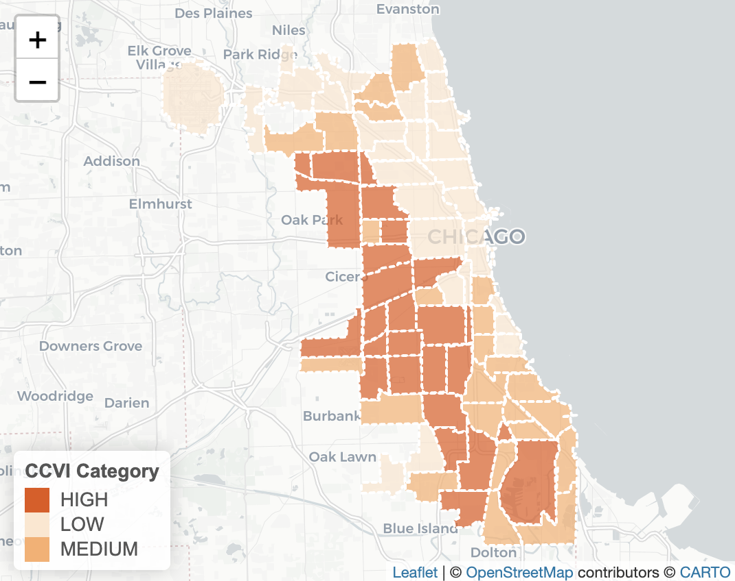
In the space below to copy/paste/insert a custom version (new color palette) of Figure 1 (map of CCVI Scores by Community Area) from the exercise.
GEO 330 Sustainable Urban Transportation
Exercise #2: L Station Ridership Trends
Describe here any patterns you see in the map. Use data from the map to describe characteristics of at least one community located within each of the three CCVI categories.
The communities with the highest vulnerability on the map seem to be located primarily in Chicago’s west and south sides. South Lawndale is a community which is in the high vulnerability category with an overall CCVI score of 58.2. It stood out to me that it also has a COVID-19 hospitalization rate of 64. This compares very differently to the Loops hospitalization score which is an astounding 0. North Park would be a medium in between the two communities with an overall CCVI score of 40.6. With a socio economic status score of 26, it sits economically just between the Loop and South Lawndale.

Slide 2
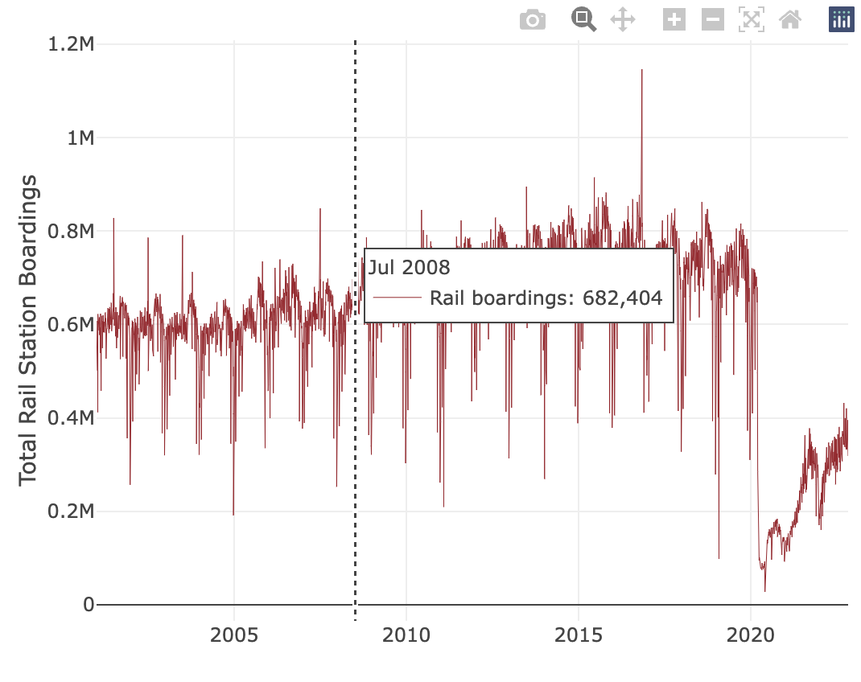
In the space below to copy/paste/insert Figure 3 from the exercise.
GEO 330 Sustainable Urban Transportation
Exercise #2: L Station Ridership Trends
Describe patterns in rail boardings between 1999 and 2022. What do you think explains some of the cyclical variations in the data? What other factors may explain ridership over this period? Draw from the daily ridership plot to characterize ridership trends during the pandemic.
Between March 10 and March 20, 2020 ridership dropped significantly. Ridership went from 678,996 down to 152,797. In a matter of ten days the CTA saw it’s most drastic decrease in ridership. Aside from the dip in ridership from COVID, ridership also seems to dip every December. I would predict this is because during the holidays people are often not going to work and/or leaving the city for the holidays.

Slide 3
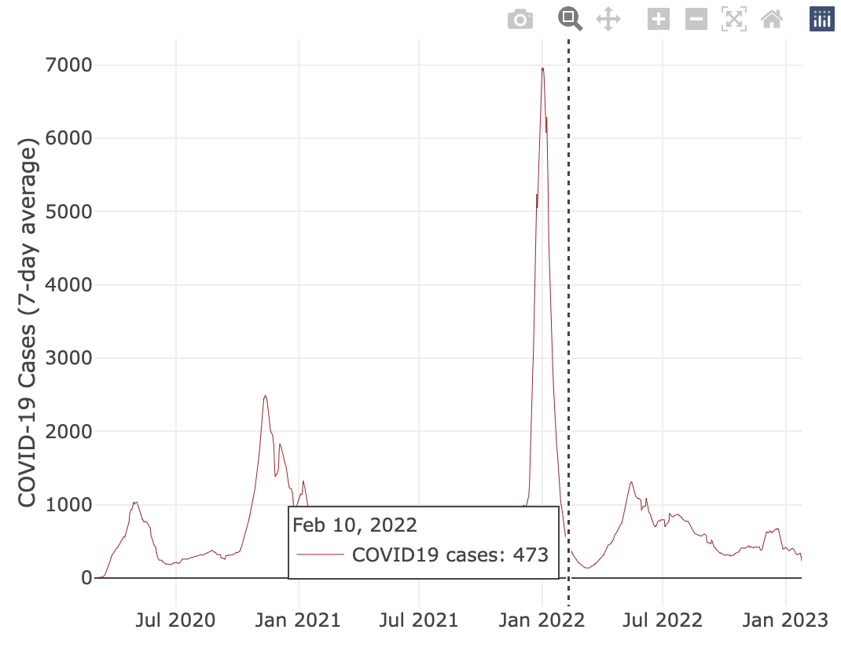
In the space below to copy/paste/insert Figure 4 from the exercise.
GEO 330 Sustainable Urban Transportation
Exercise #2: L Station Ridership Trends
Are the waves and phases of the pandemic evident? Compare these pandemic phases to ridership trends over the same period. Do they appear to be related?
Yes, the waves and phases of the pandemic do seem to be evident. The most noticeable surge appears to be in January of 2022 when the omicron variant was running rampant. Ridership seemed to decline more so at the beginning of the pandemic when numbers were actually much lower than they were in January of 2022. Ridership actually stayed increasing in January 2022. I figure many people were tired of being locked down and may have just opted to continue to mask on public transport.

Slide 4
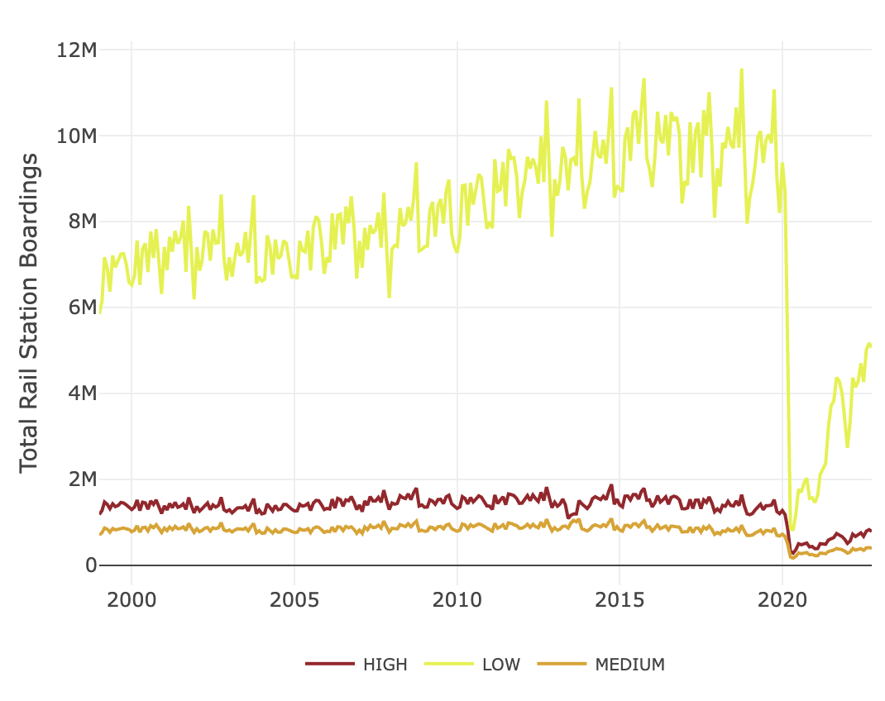
In the space below to copy/paste/insert Figure 5 from the exercise.
GEO 330 Sustainable Urban Transportation
Exercise #2: L Station Ridership Trends
How does ridership vary with respect to station CCVI and line?
Ridership is much higher in the stations in that have a low CCVI. Rideship tanks when when the pandemic occurs for all CCVI stations. It may be true though that low CCVI stations may have such great ridership because of the abundance of stations in these communities. For instance, the Loop has the greatest density of stations in the city and has a low CCVI score. I would figure that this would skew the low ridership data.

Slide 5
Summarize some potential short- and longer-term implications the pandemic has had on sustainable transportation and public transit ridership?
Ever since the pandemic ridership has taken a severe hit that I am not sure will be ever able to recover to its previous stature. Many people may still be afraid to risk falling ill on the CTA and opt for other modes of transport. Additionally, many people work from home and do not have to use the CTA for work. Many people in Chicago often live within walking distance from essentials like the grocery store. Therefore, the use of public transit is not needed for those things either.
GEO 330 Sustainable Urban Transportation
Exercise #2: L Station Ridership Trends
What strategies do you propose to help return transit to pre-pandemic levels?
One thing that I think may be beneficial to increase public transit ridership in Chicago would be the introduction of a congestion charge for people who drive in the city. I think this would greatly reduce the amount of drivers during rush hour in the city especially downtown. This would increase the amount of riders. Additionally, in my experience the CTA has had a lot of problems staffing trains since the pandemic and this has caused a lack of buses and trains often times creating delays and even “ghost trains/buses”. The CTA should create incentives and possibly greater pay for these operators in order to fill these positions ASAP.

